Slide 1
RuBAN Monitor

Slide 2
Task
Tasked to find a way to record and monitor metrics of RuBAN instances around the globe
Side project on top of testing!

Slide 3
What we do now
Monitor through Alex and Alan's monitoring
  Crafted through necessity
  Do not have all required information
  Not yet embedded into RuBAN

Slide 4
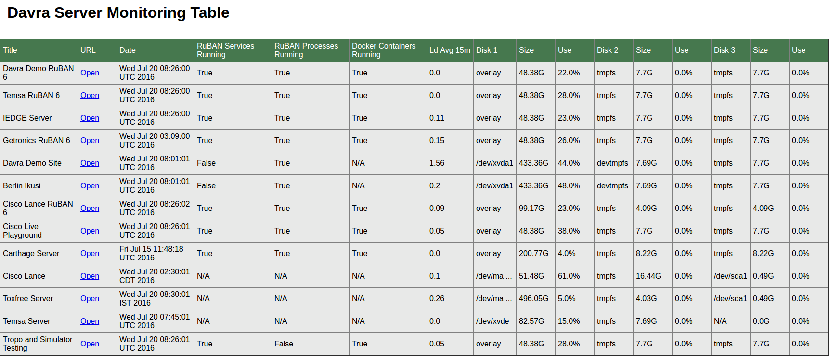
Alex's Monitor

Slide 5
Alex's Monitor
Currently Alex's monitor can:
  Check if RuBAN processes are running
  Check if RuBan services are running
  Check if Docker Containers are running
  Disk Usage reports (Usage, free space etc..)

Slide 6
Alan's Monitor
Currently:
  Monitors activity on his server and if below a certain threshold throws a notification that the server is inactive.

Slide 7
The goal
What we want is:
  Something to report to a central RuBan Server with customers metrics, version around the globe.
  We want it to use the current Api's RuBAN has
  We want to embed it into the RuBAN install to make it automatically work
  We want to keep in mind the more than likely possibility of SaaS architecture.

Slide 8
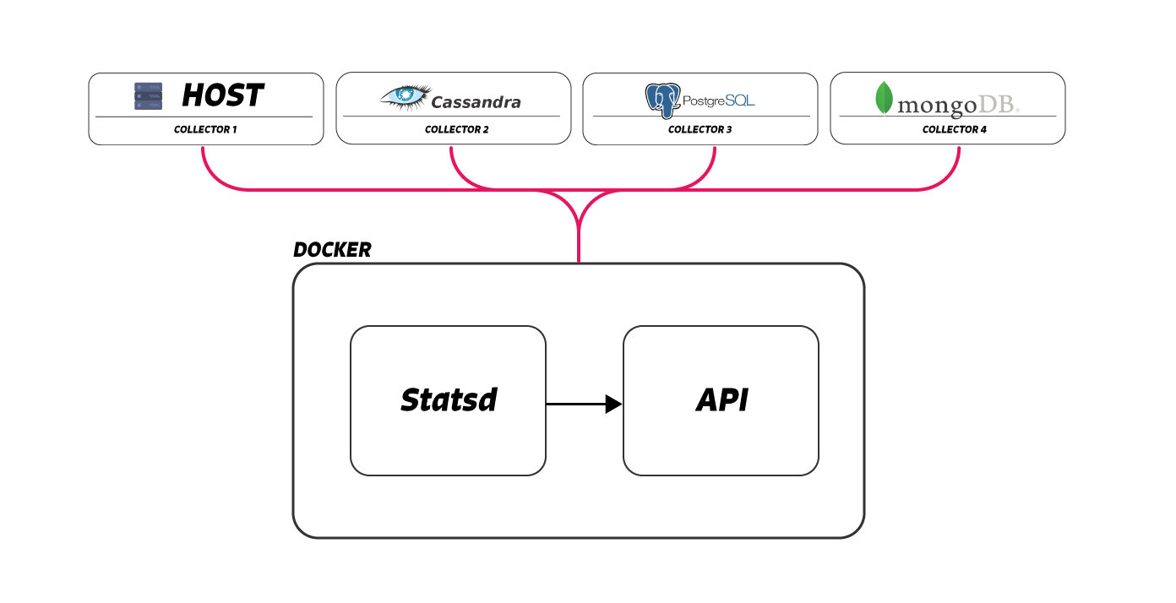
The Proposed Solution

Slide 9
The Proposed Solution
What are these?
  StatsD - A tool that listens on a specified tcp port and you push whetever metric you wish to record for a regular time interval.
    Uses agents that install directly to third party applications (Cassandra or Mongo) and reports to a StatsD host server.
  CollectD - Another tool that just focuses on the host metric like disk space free and cpu usage

Slide 10
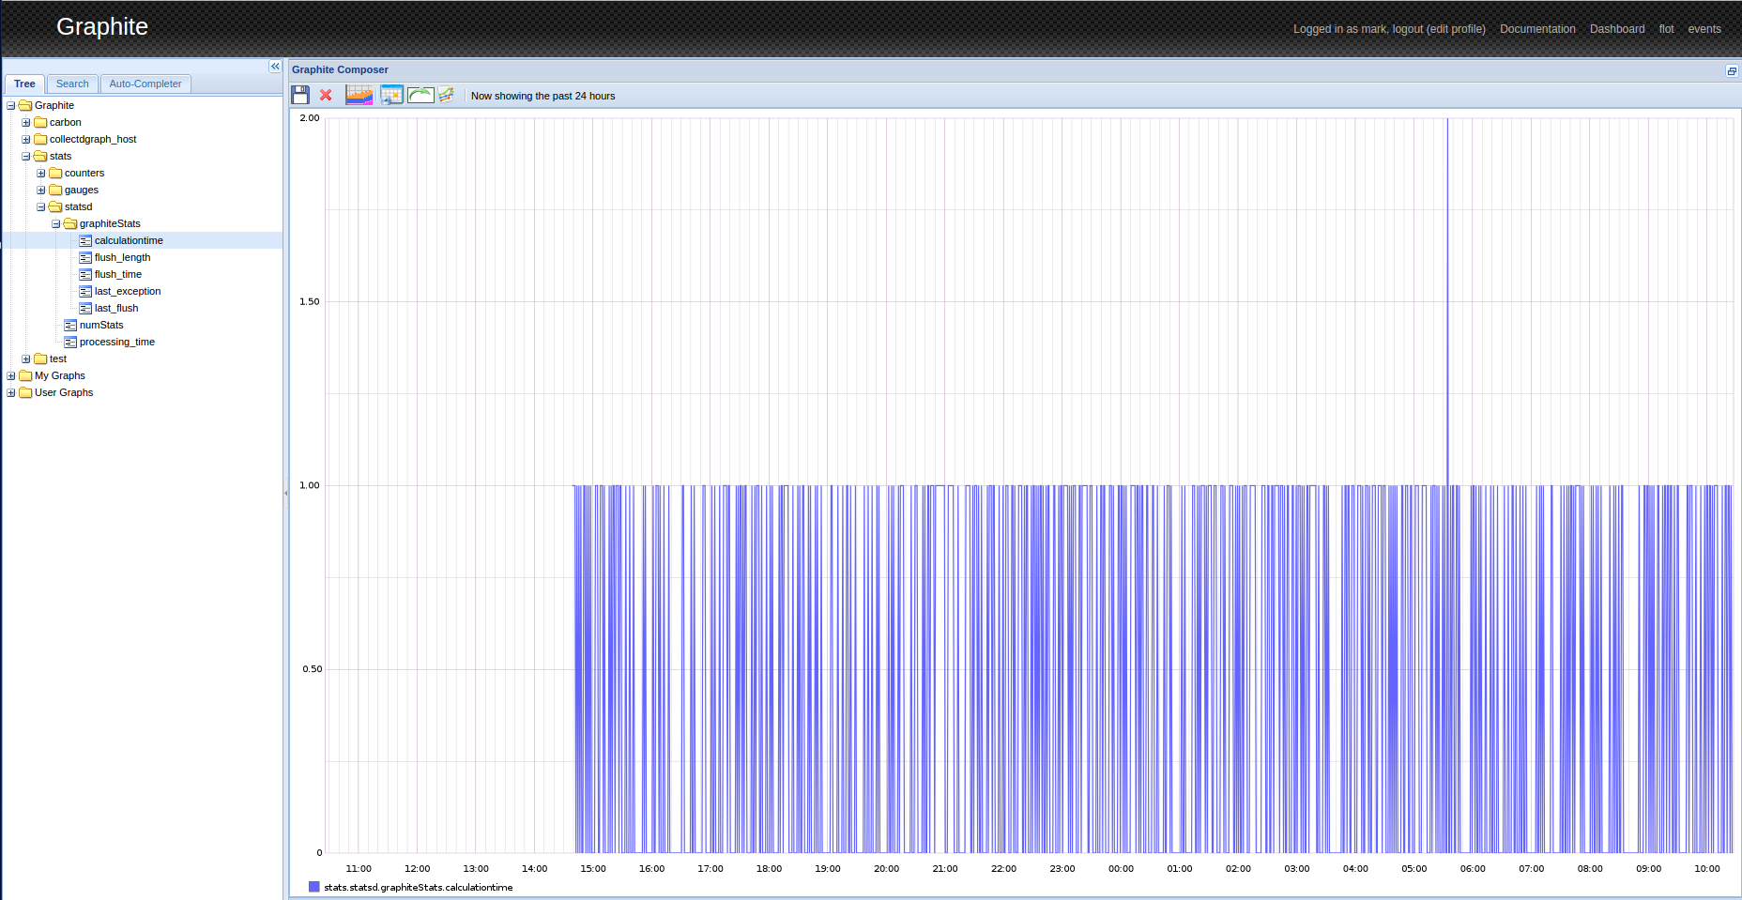
The Proposed Solution
Working right now:
  We have a machine running StatsD, CollectD and Graphite (graphing web server)

Slide 11
The Proposed Solution
Continued Development:
  Get the StatsD and CollectD to report directly to a RuBAN instance.
  This can be done through a custom backend written in javascript deployed on the StatsD host
  Allows us to customize how we route, package and record the data from the collecting agents.

